Slide 1
Car accident severity
By Toshini Agrawal
Mentor- Dr. Ranju Mohan
USING KNN,DECISION TREE &LR

Slide 2
INTRODUCTION
All big urban cities whether it is Barcelona, Tokyo, Mumbai or Seattle, share one common attribute i.e. they are dense (more people packed in less space). This high density of people and vehicles combined with dynamic nature of city life creates an interesting set of challenges for the public office holders (mayor, city council members, etc.), city/transportation planners and other emergency service providers such as police, fire and medical technicians. One such challenge is "Traffic Collisions" and it has multiple negative consequences, such as:
It can result in loss of human life or a life altering serious injury.
It can result in property damage/financial loss to both the people involved and the city.
It can cause traffic jams lasting hours which can result in billons of dollars in lost productivity.
It creates unsafe road conditions for other drivers.

Slide 3
GOAL
The goal of this project is to:
Take a deep dive into the "Collisions" historical dataset for the city of Seattle
Discover the statistical relationships between different variables
Build Regression and Decision Tree model to deliver accurate predictions for "Injury" and "Property Damage" variable

Slide 4
DATA DESCRIPTION
The raw data under consideration for this project is the 'Collision Data" sourced from the Seattle Police Department for the year 2004-2020. Actual dataset is much larger. But, for this project I have limited the scope of the dataset to focus on two variables "Property Damage Collision" and "Injury Collision".
Preliminary analysis suggests that data is mostly clean and complete. However, some cleaning might be required to make it ideal for modeling and analysis. Size of the dataset is approx. 195K rows and 38 columns. Dataset is of medium complexity as there are multiple variables that can potentially impact the severity of the collision. Data is of mixed nature with integer, float, date and categorical variables being present. That means, it will require preprocessing and potentially normalization.

Slide 5
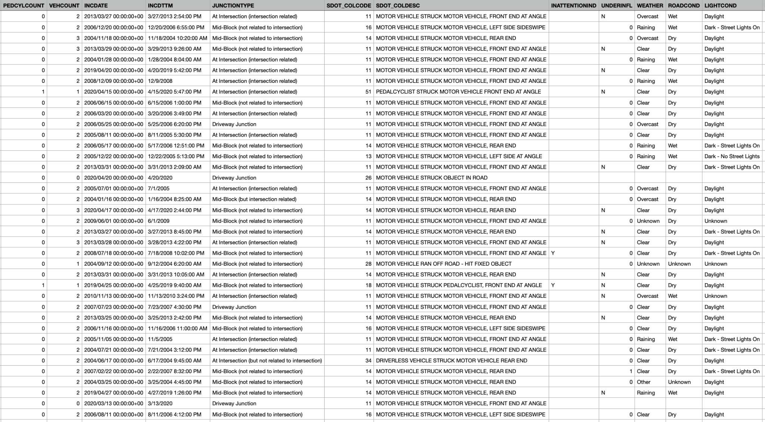
DATA

Slide 6
DEMO
https://drive.google.com/file/d/1unSChM_O3KzeChNVruBIe4D8LaDLzsrJ/view?usp=sharing

